Slide 1
PREDICTING FACTORY DEMAND
Illan Bermejo & Miguel Ruiz

Slide 2





AGENDA
Project
Data
Prediction
Visualization
Conclusion & Improvements

Slide 3
THE PROJECT
1
Client: needs better predictions in order to improve workforce scheduling & procurement.
2
Currently: expert knowledge, rule of thumb and over-resourcing.
3
Project: clean 10 products & forecast for 1
4
Objective: beat current procedures & demonstrated the power of the data

Slide 4
RAW DATA
original_b2.csv
stores_locations.csv
products.txt
Other
transaction data from 01/01/2018 to 30/09/2019 1607908 lines x 23 columns
store geolocation
text data with the online catalogue of mallorca
football matches, weather, local festivities, etc.

Slide 5
DATA CLEANING
Data understanding
Products normalization
inexplicable behavior had to be clarified by the client, and outliers, nulls and duplicates were treated
Data to Transactions
data was transformed into a transaction shape
Levenshtein distance + fuzzywuzzy + manually made dictionary of products:
'trta','taarta', 'tartita' = 'tarta'
Raw
Processed
Exploratory Data Analysis
Extracting the products
Feature engineering
multi-rule filters to extract the time-series of the top 10:
1 time series - 1 product
added external variables to analyze orders correlations, and transformed for ML
over 45k product descriptions for 1,5k products.
- 'trta','taarta', 'tartita' - N-N product id - description

Slide 6
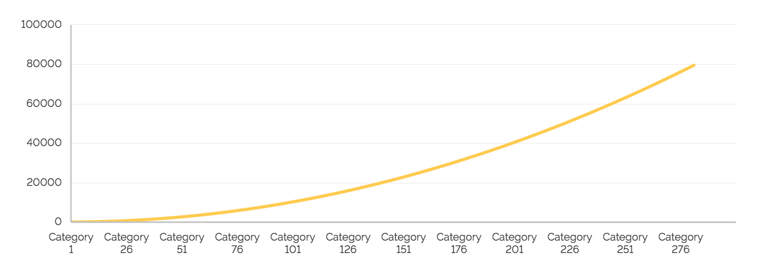
TIME SERIES ANALYSIS
Pendiente de completar…
Propongo poner nuestra serie temporal + los principales resultados de los análisis de la serie y, ya de boca decir los test que hemos aplicado
Main Observations from the time series

Slide 7
MODELS
BENCHMARKS
SARIMA
median - weighted median - naive guess
similar to ARIMA with seasonality component
EXPONENTIAL SMOOTHING
PROPHET
great performance with trends and seasonality
fb library for trend + seasonality + holidays
ARIMA
RANDOM FOREST
good when the weight is on the first lags
machine learning

Slide 8
BETTING TIME...
WHICH MODEL PERFORMED THE BEST?

Slide 9
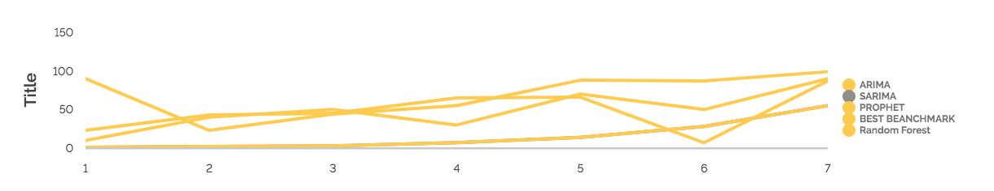
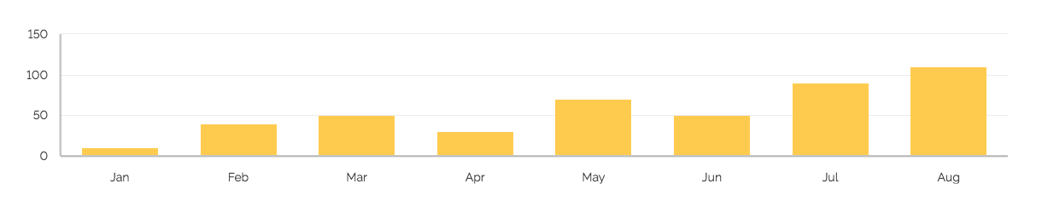
RESULTS
Pendiente de completar…
Propongo poner la gráfica con los errores y, abajo un barchart con los errores
Conclusions...

Slide 10
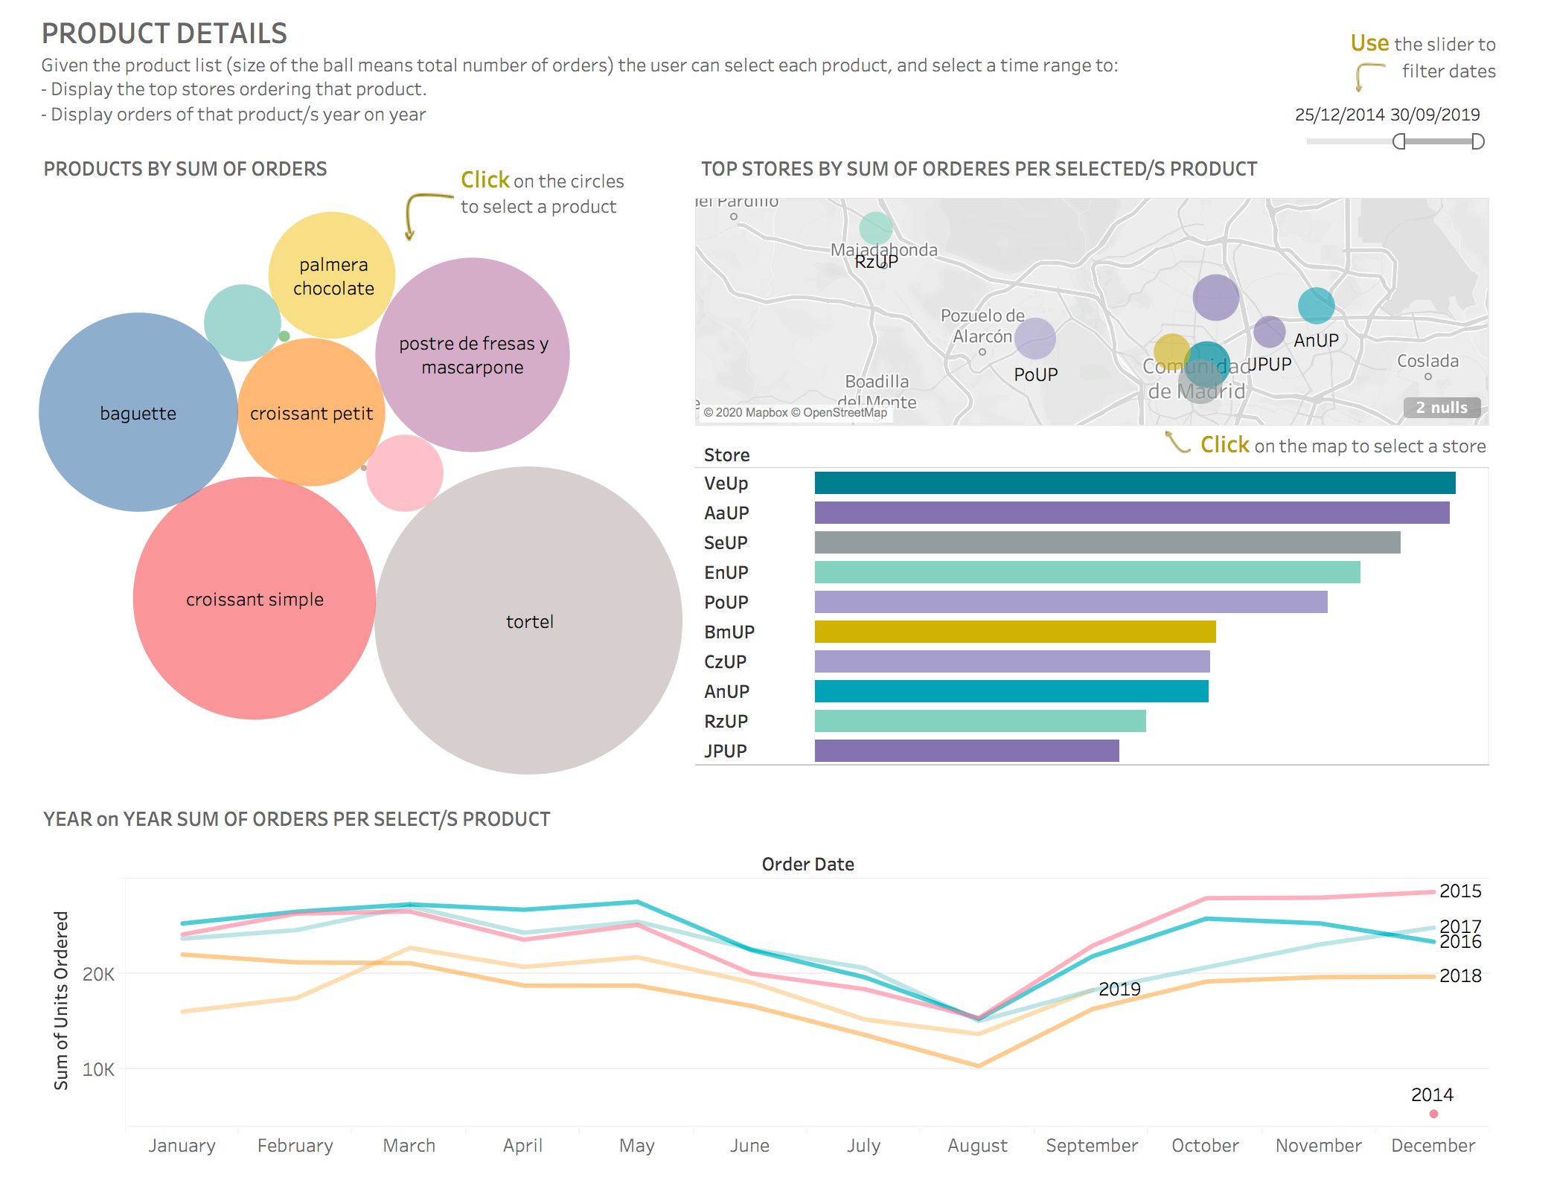
FRONT END

Slide 11
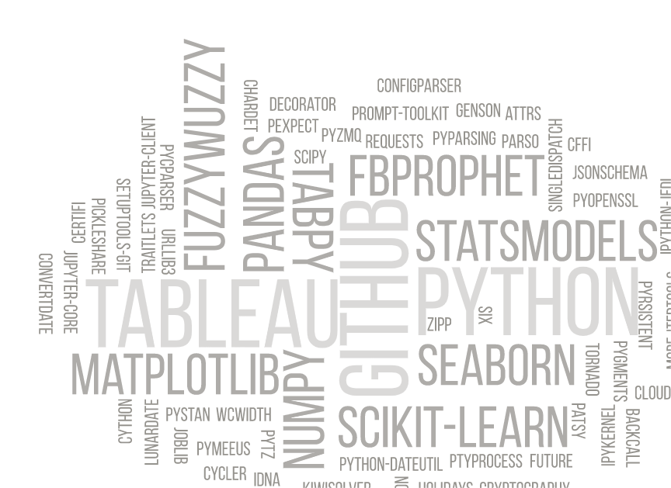

Slide 12
REAL vs PREDICTION
Data quality
TabPy for Tableau
we truly spent 80% of the time cleaning data
not intuitive
Github and Git Large File coordination
Data reality
business decisions affected the quality of the prediction
pull request cannot be merger, pull request cannot be merged...
Modin & Prophet compatibility
bugs, bugs everywhere

Slide 13
CONCLUSIONS AND IMPROVEMENTS
1
Client would benefit from predictive models
4
Multi variant SARIMA & Random Forest
2
Working as a team yields more creativity
5
Take into account weekly and yearly seasonality
3
ML is not always the winner
6
Split to weekly average and difference between date and mean

Slide 14
THANK YOU

